Slide 1
Business Management
Systems
ERP & MRP

Slide 2

BUSINESS MANAGEMENT SYSTEMS SOFTWARE
Helps the streamline process
Cuts costs
Saves time
Improves profit margins
Improves the ability to serve clients
Two main systems: MRP and ERP

Slide 3
MATERIAL REQUIREMENT PLANNING
MRP
This is a system to calculate the materials that are needed in manufacturing a product.
It works for:
- Bill of materials (BOM)
- Inventory data
- Master production schedule
This is the main information required to program the manufacturing process

Slide 4
MATERIAL REQUIREMENT PLANNING
MRP
BENEFITS OF MRP | DISADVANTAGES OF MRP
Reduces the customer times | Inventory increased costs ensuring that production is done on time
Improves customer satisfaction | Lack of flexibility, it is a rigid and simplistic system
Reduces inventory costs | Data integrity is needed so if the information is mistaken information could be magnified later in the process
Improves manufacturing efficiency using the planning and scheduling | Data management is also dependent in information input correctly
Optimizes the use of labor and equipment | Missing the integration of the other departments such as financials, designing, cost management and more.

Slide 5
MRP SOFTWARE
NAME | DESCRIPTION | RATE
Proshop | Web-based shop management system intended for small to medium sized machine shops, regulated industries requiring ISO-9000, AS9100, API, 13485, or other certifications | 5.0
Realtrac | This system processes and tracks jobs in real-time from estimating through order entry, loading, scheduling, purchasing, routing, inventory, job costing, shipping, invoicing, quality and management reports. | 4.1
Infor Visual | It supports costing, scheduling & material planning tools, with a personalized user interface | 4.4
BizAutomation | Includes full GAAP Accounting, CRM, ERP, Order-Management, Inventory and Warehouse management, e-Commerce | 4.9
Prodio | Production management software designed to help all operational processes | 4.0
M1 | Software for job shops, make-to-order manufacturers and custom & mixed mode manufacturers | 3.7
Fulcrum | This system has been designed to help manufacturing businesses with job scheduling, quotes, production tracking, inventory management, and quality control | 5.0
Wherefour | System to assist process manufacturers manage inventory, forecast future need, plan production, manage customer orders | 4.9
Smart IP&O | Web-based, integrated suite with modules designed to help businesses to track business metrics and forecast accurately to optimize service levels. | N/A

Slide 6
NAME | DESCRIPTION | RATE
Prodsmart | It is a complete one-stop-solution for production environments that helps SMBs leverage the power of data. | 4.6
Atlas Planning | It is a user-friendly, AI-driven, cloud-based, end-to-end supply chain planning solution that helps businesses across all industry verticals. | 4.6
Sage 100cloud | It is designed to help businesses manage processes related to manufacturing, production, and distribution. | 4.0
MasterControl Manufacturing Excellence | SaaS platform designed to help businesses streamline inventory tracking, resource planning, and supply chain operations. | 4.6
Oracle NetSuite | It runs all of your key back-office operations and financial business processes | 4.1
xTuple | Manufacturing and inventory-centric companies use this management software and best practices to grow their business. | 4.2
Fishbowl | Complete manufacturing and inventory management solution designed for medium and large businesses | 4.2
QT9 ERP | Manage accounting, purchases, sales, inventory, production, payments, and more. | 4.9
E2 Shop System | Provides total shop control. Manufacturing software to reduce costs, eliminate chaos, and ship products on time. | 4.3
Katana MRP | Smart and visual inventory & manufacturing management software tailored for scaling manufacturers | 4.8
Genius ERP | All-in-one enterprise resource planning (ERP) solution for SME manufacturers with features for managing inventory, projects, customers, employees, vendors, accounts, and more | 4.2
MIE Trak Pro | ERP software with which manufacturing businesses can control inventory, track jobs & schedule purchasing | 4.6
Odoo | Fully-integrated, customizable, and open-source suite of business applications. A majority of the business needs such as CRM, Sales, Project, Manufacturing, Inventory, and Accounting | 4.2

Slide 7
ADVANTAGES OF ERP VS. MPR
The difference ERP comes with additional applications for:
Making Estimations
WIP- Work in Progress
Multilevel BOM - Bill of Materials
Configurator
Employee timecard entry
Disposition management
Service/repair
Field service capabilities

Slide 8
ENTERPRISE RESOURSE PLANNING - ERP
Modules that integrate departments within a company, such as:
Accounting and Finance
Sales and Marketing
Human capital
Customer relationship
Purchasing management
Inventory management
Distribution management
Quality management.
Project management

Slide 9
ENTERPRISE RESOURSE PLANNING
ERP
Easy for users to convert a quote into an order.
Helps keep track of estimated and actual costs.
Route certain jobs to different locations or outside vendors.

Slide 10
OPEN
SOURCE
ERP
OpenPro
WebERP
Opentaps
Apache OFBiz
BlueSeer
Dolibarr
ERPNext
Easy ERP
inoERP
iDempiere
LedgerSMB
Metasfresh
MixERP
Odoo

Slide 11
ERP VENDORS
Enterprise | Medium Sized Business | Small Business
SAP | Netsuite | Deltek
Oracle | Sage | Work(ETC)
Microsoft Dynamics | Infor | Syspro
Unit 4 | Macola | Intacct
Cetec ERP

Slide 12
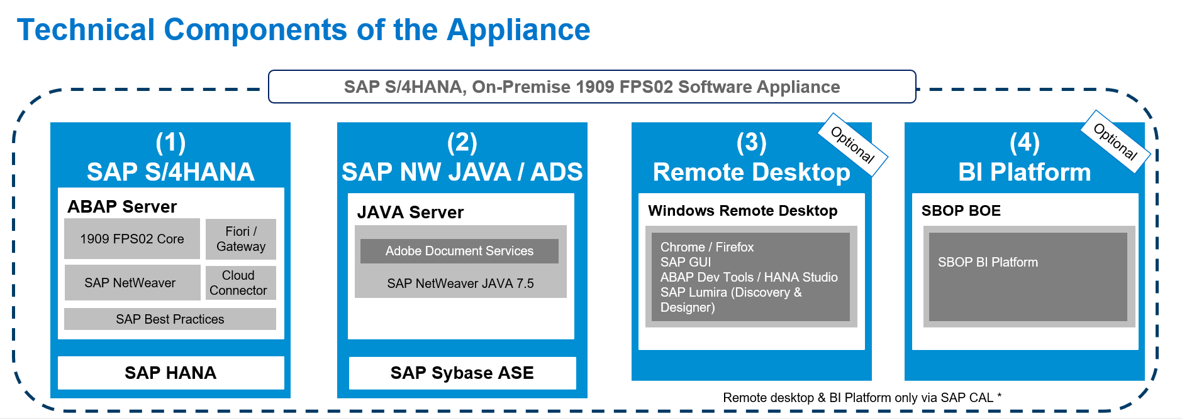
1. SAP
Businesses can make better and faster decisions since it gives embedded analytics, conversational interface and digital assistance.

Slide 13
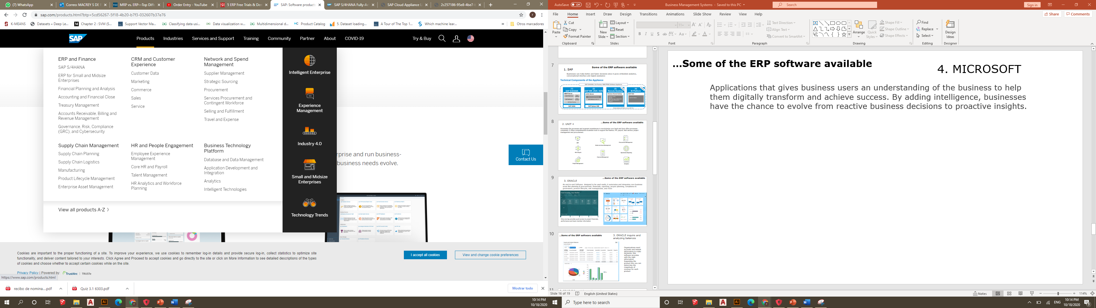
SAP’s wide amount of products
SAP has products for all business processes across all industries to find solutions in order to run business better, faster and simpler.

Slide 14
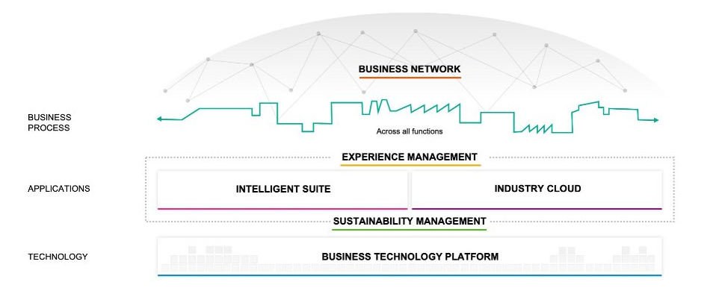
SAP and Intelligence Enterprise Strategy
Business network helps to digitalize cross company business processes, it gives solutions for helping intelligent enterprises work together to create flexible value chains.

Slide 15
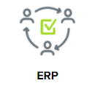
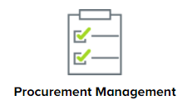

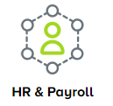

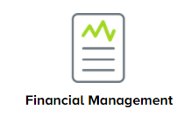
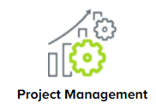
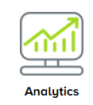
2. UNIT 4
Automates the processes and augment experiences to revolutionize your back and front office processes completely. It offers comprehensive business tools to support the finance, HR, payroll, field service, project management and procurement.

Slide 16
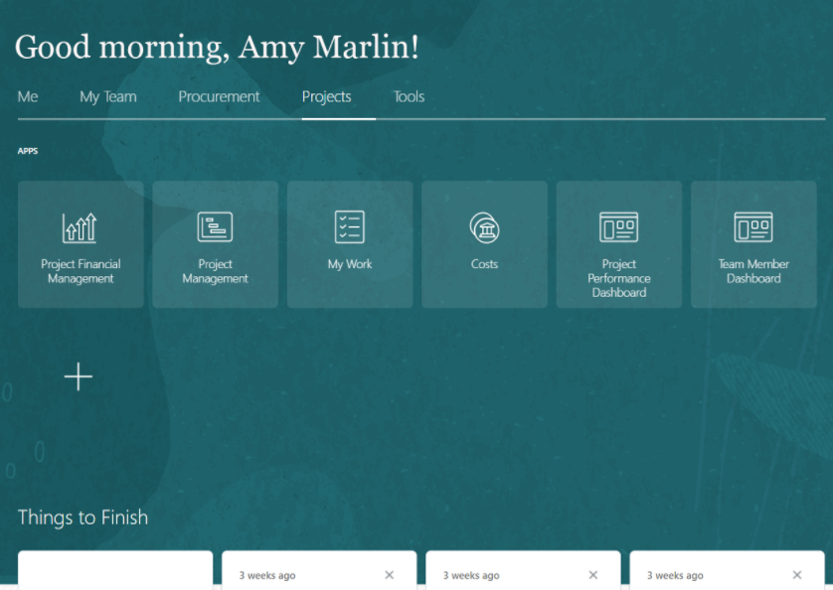
3. ORACLE
An end-to-end Software designed to be used easily, it automates and integrates core business areas like planning & procurement, financials, reporting, project planning, compliance & governance, product lifecycle, risk management, and more.

Slide 17
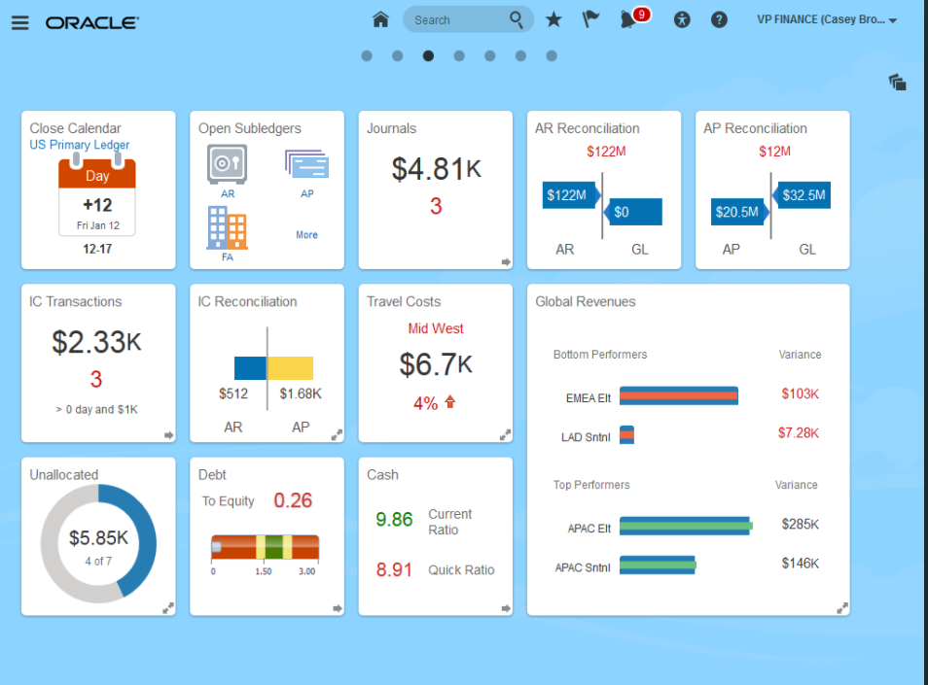
Only one tap provides quick access to project financials, performance and team member information.

Slide 18
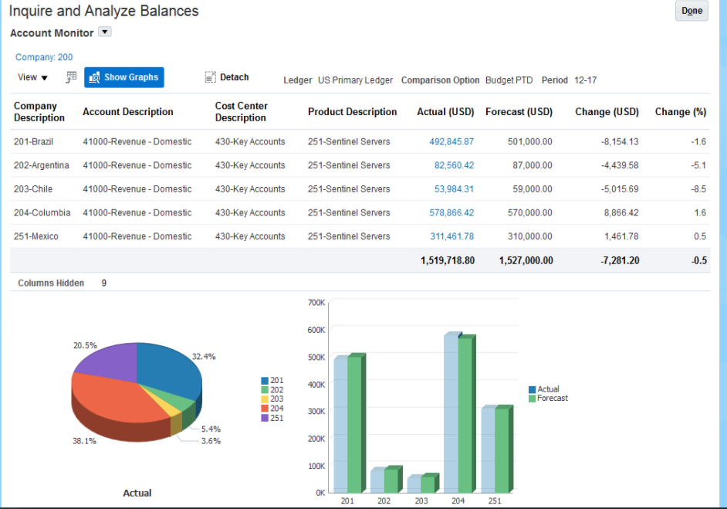
3. ORACLE inquire and analyzing balances
Organizations need accurate and instant information to make decisions, this software provides with the right information. Expanding the product line you can determine the magnitude of revenue for each product.

Slide 19
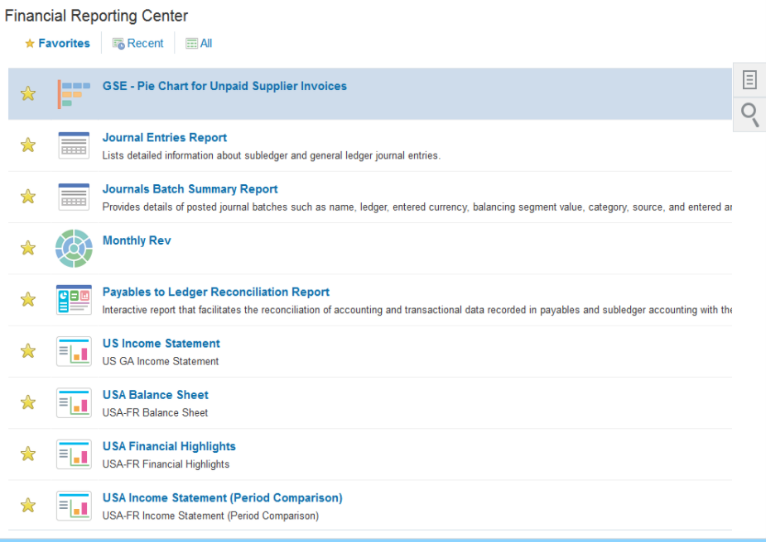
3. ORACLE financial reporting center
All reports are centralized and are easy to access from the financial reporting center.

Slide 20
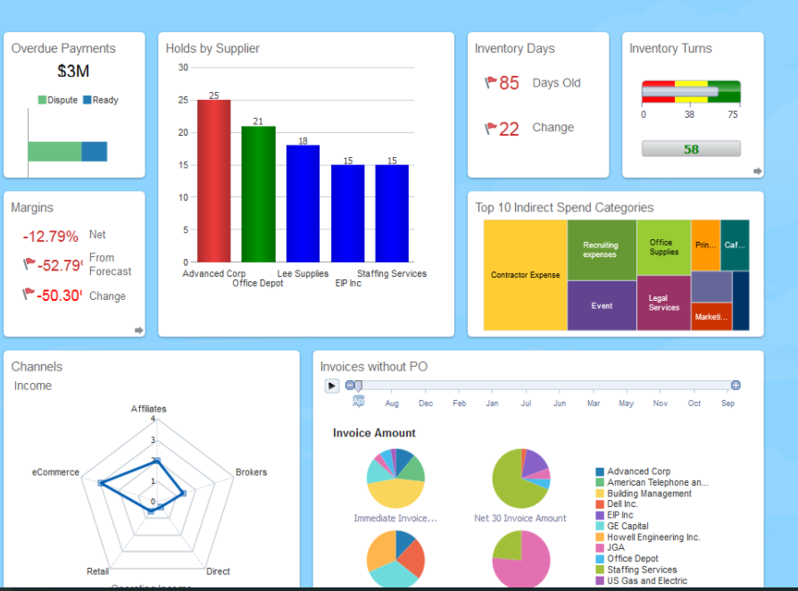
3. ORACLE financing reporting
Dashboards can be configured in order to provide managers analysis to be able to take the right decisions.

Slide 21
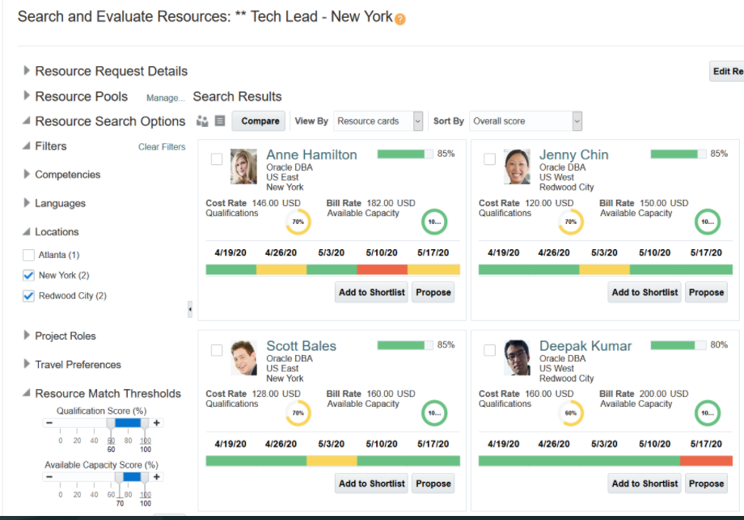
3. ORACLE Project Manager Team’s Individual performance

Slide 22
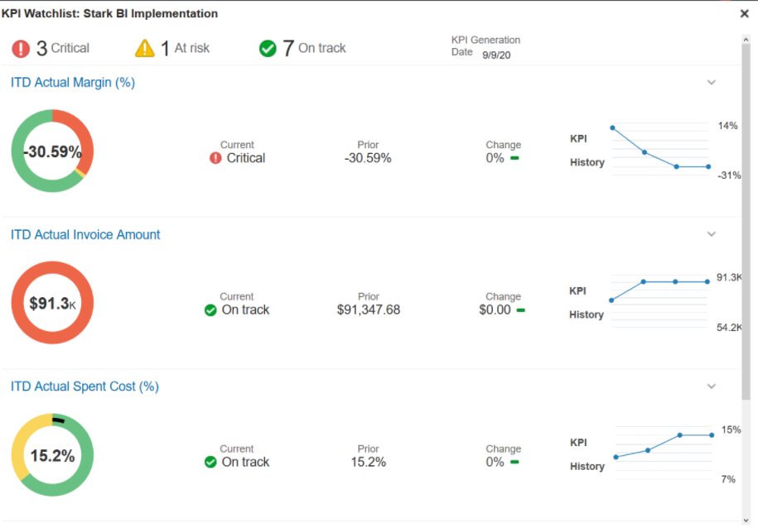
3. ORACLE Project Manager Overview

Slide 23
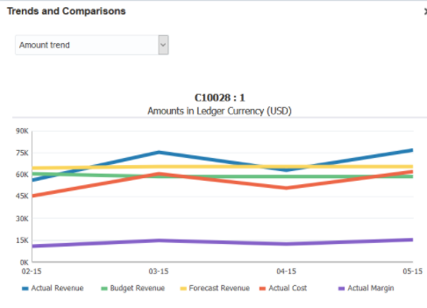
3. ORACLE Project Manager Overview

Slide 24
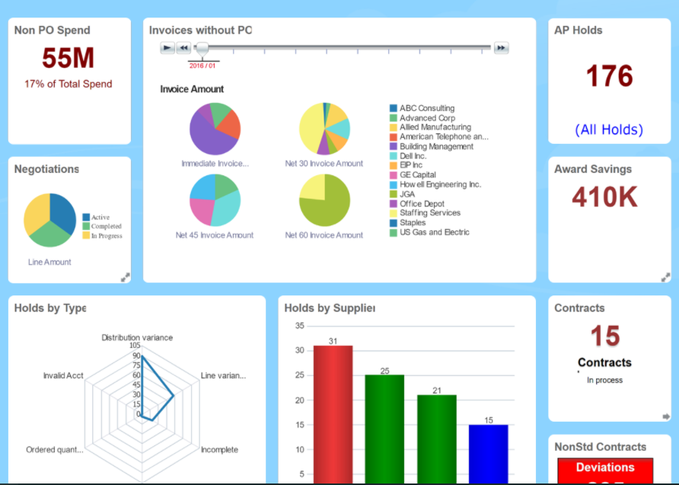
3. ORACLE
Procurement cloud offers a consumer buying experience for all business goods and services to simplify requisitions reducing rogue purchasing.

Slide 25
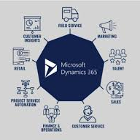
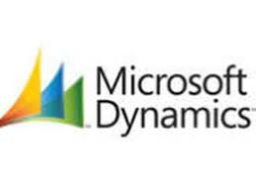
4. MICROSOFT Dynamics:
Applications that gives business users an understanding of the business to help them digitally transform and achieve success. By adding intelligence, businesses have the chance to evolve from reactive business decisions to proactive insights.
Sales
Customer Service
Field Service
Project Service Automation
Finance and Operations
Business Central
Human Resources
Retail

Slide 26
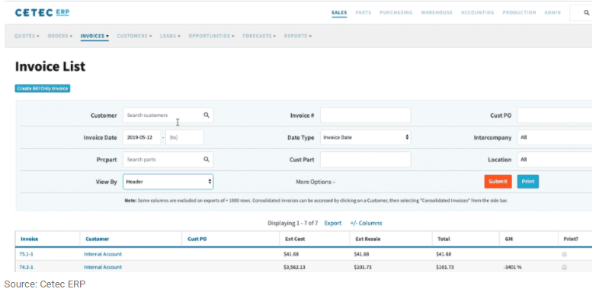
5. CETEC ERP
CETEC ERP cloud-based ERP platform for manufacturers and distributors.
This web-based ERP tool digitally transforms your business with a simple and affordable SaaS platform.

Slide 27
ALL IN ONE
5. CETEC ERP
All in one platform that offers all that is needed in a business, from inventory, shop floor control, quality management, financials, etc. It is made with practical tools for handling difficult requirements and therefore track dynamic production.
ERP + MRP + CRM + QMS
Stays continually updated
Constant maintenance
Handled by tabs in browser
Can work remotely
Information can be pulled out on mobile tablets

Slide 28
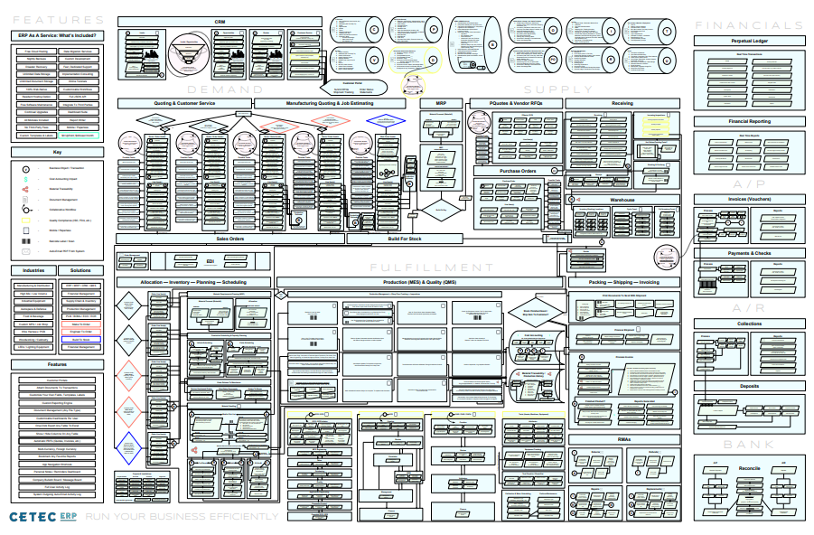
FLOWCHART
5. CETEC ERP

Slide 29
Steps for ERP implemention
Bring together and ERP implementation team
Create an ERP budget
Choose implementation consultant
Cleanse and migrate your ERP data
Train your key ERP user groups
Adapt your business to your new ERP
Evaluate the success of your ERP implementation
Planning sheet

Slide 30
homework
Which of the 2-business management system is better? Why?
Can an MRP help a construction company? In what ways?
Can an MPR help a toy factory? In what ways?
What ERP elements would be necessary to have in an accounting firm?
Have you used any ERP system at work? If so, how did it help you be more efficient in your job?
SEND TO:
catalina.cantu01@utrgv.edu

